Slide 1
Question Generator
Library used:
https://spacy.io/
https://github.com/summanlp/textrank

Slide 2
Text Class
I choose short stories for kids as my text class
Specifically animals stories
All stories that I worked on are from this website
These stories are short
Contains sentences mostly in past tense

Slide 3
Question types
I choose four types of questions
Noun phrases
Verb phrases
Who said a Quote
Question about a Quote

Slide 4
Noun Phrases
In these type of questions I used spacy noun_chunk feature
Using spacy I found the noun_chunk of a sentence whose root is subject of the sentence
Then I replace that noun_chunk with ‘Who’
Generating a syntactically correct question

Slide 5
Noun Phrases - Example
A quick fox jumps over the lazy dog, noun_chunks
Sentence:
The quick fox jumps over the lazy dog
Question:
Who jumps over the lazy dog
Text | Root text | Root dep | Root pos | Root head | Head pos
The quick fox | fox | nsubj | NOUN | jumps | VERB
the lazy dog | dog | pobj | NOUN | over | ADP

Slide 6
Verb Phrases
In this type of questions I again used dependency tree
I iterate over each token, reaching to the ROOT of the tree If ROOT is VERB
Now from this ROOT I append left tree in my question text And replacing the right tree with a ‘what?’
Also if the next child of ROOT is prep or prt I append them in my question text too

Slide 7
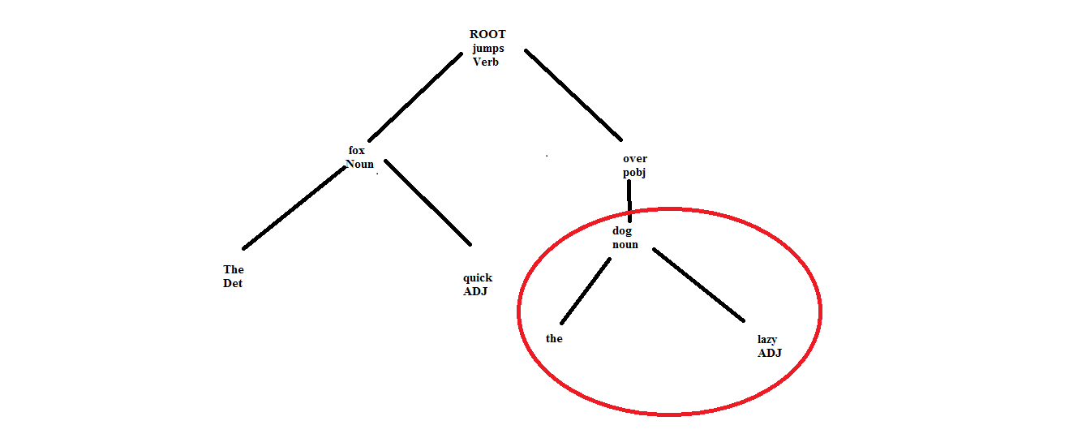
Verb Phrases - Example

Slide 8
Verb Phrases - Example
For verb phrases questions
I replaced the right tree in diagram highlighted with red circle
With ‘What?’
Generating a syntactically correct question
Sentence:
The quick fox jumps over the lazy dog
Question:
The quick fox jumps over what?

Slide 9
Who said a Quote
In this type of questions I have sentences with quotes
E.g. "Will you be my friend?" asked the elephant.
I split quoted and unquoted text from the sentence
And replaced noun _chunk of unquoted text with who?
Generating: "Will you be my friend?" asked who?

Slide 10
Question about a Quote
In this type of questions I have sentences with quotes iin which the quotes are at end
E.g. The elephant walked up to the tiger and said, "Please, Mr. Tiger, do not eat up these poor animals."
I again split the sentence on Quotes
Replacing the last quotes with ‘what?’, Generating:
The elephant walked up to the tiger and said what?

